Slide 1


Characterization of the Pre-Lytic Active Egress of a Non-Enveloped Virus

Slide 2
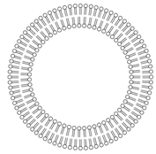
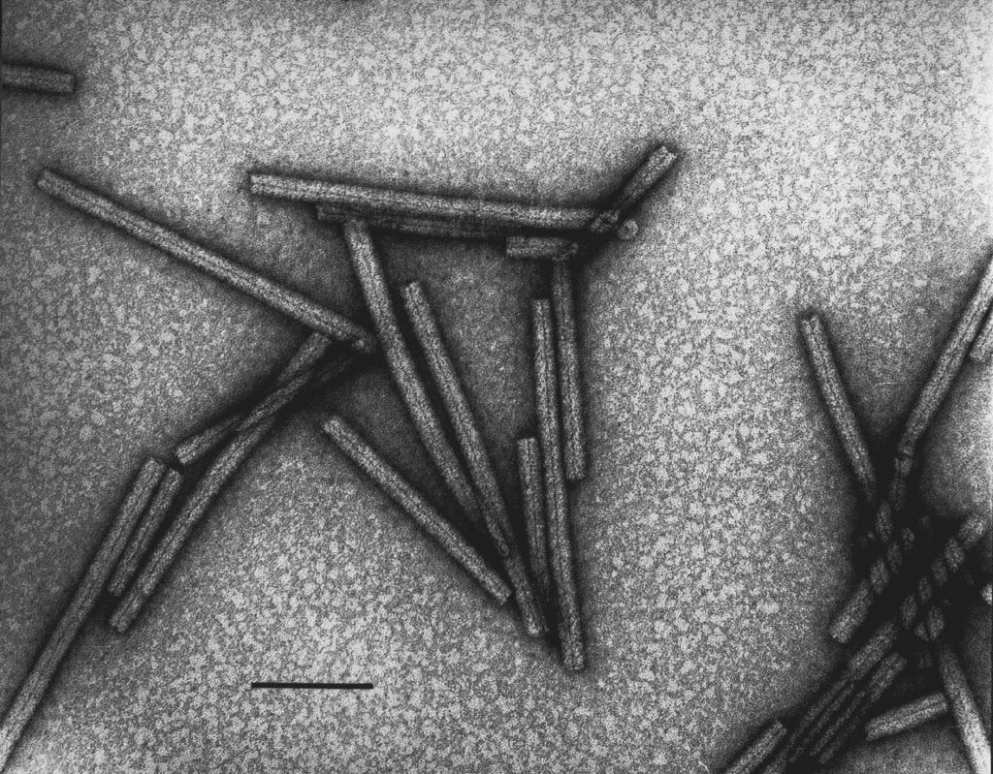
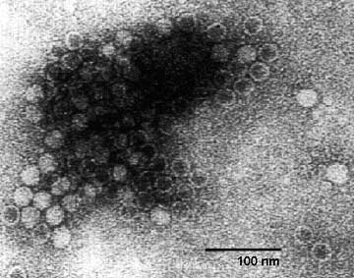
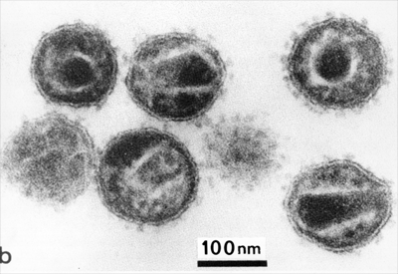
The Nature of Viruses
1/45
Viruses…
Infect all types of life forms (animals, plants and microorganisms, including bacteria and archaea).
Appear in every ecosystem on earth.
Consist of two or three parts:
Genetic material made from either DNA or RNA
Protein coat, called the capsid
Envelope of lipids that surrounds the protein coat (Enveloped viruses)
Can adapt a wide diversity of morphologies
Enterobacteria phage T4
(Myoviridae)
Tobacco Mosaic Virus
(Virgaviridae)
Minute Virus of Mice
(Parvoviridae)
Human Immunodeficiency Virus
(Retroviridae)
100 nm
100 nm
Complex with prolate head
Helical
Icosahedral
Enveloped

Slide 3
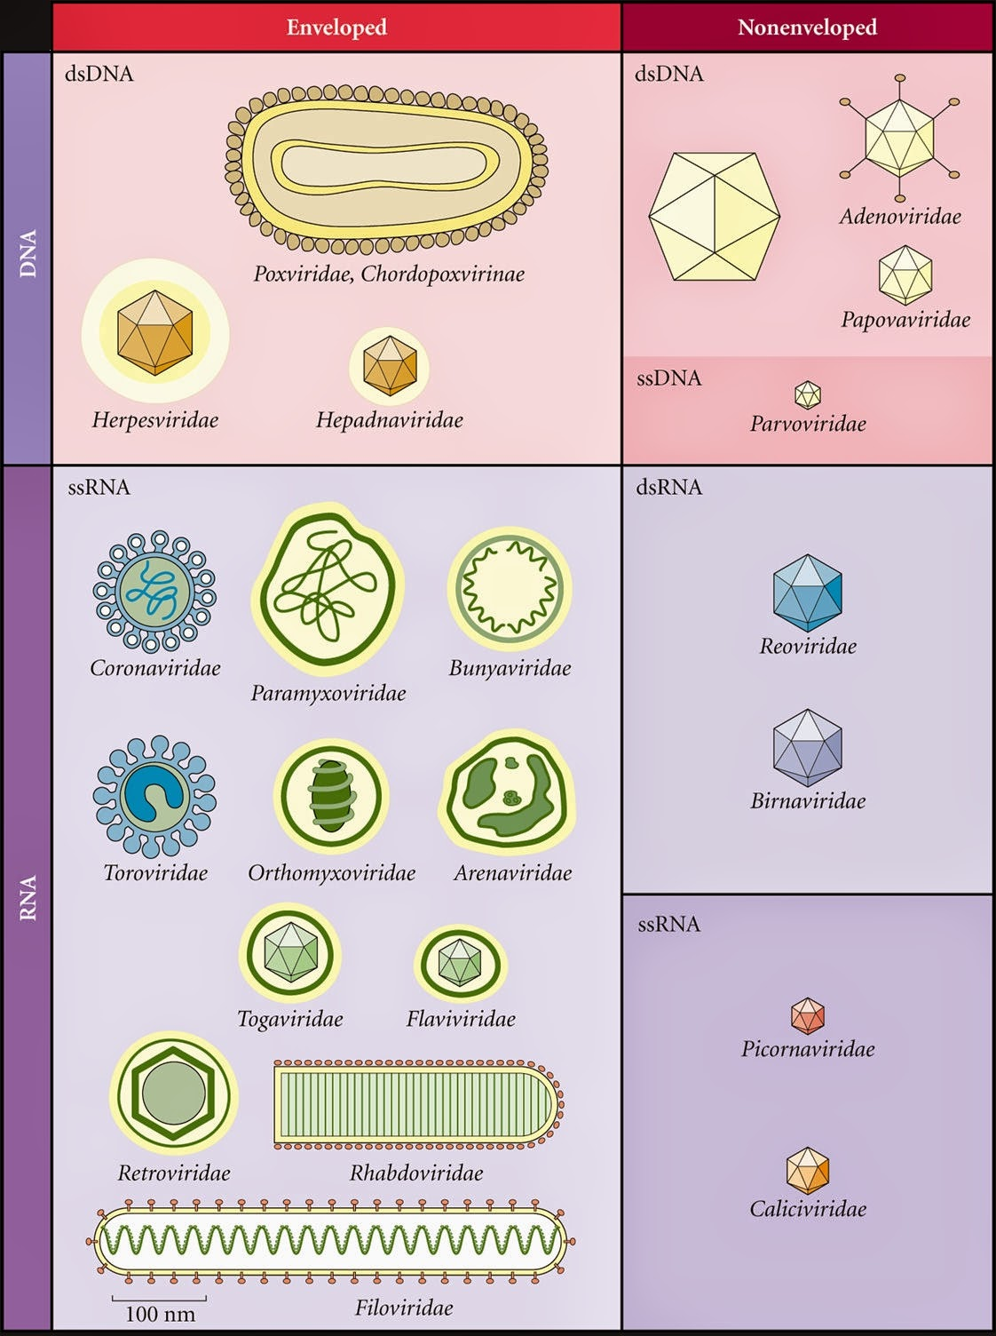

Vast Diversity of Viruses
Enveloped
Non-Enveloped
International Committee on
Taxonomy of Viruses (ICTV)
Phenotypic characteristics
Morphology
Nucleic acid type
Mode of replication
Host organisms
Type of disease
DNA
Baltimore Classification
Mechanism of mRNA production
RNA

Slide 4
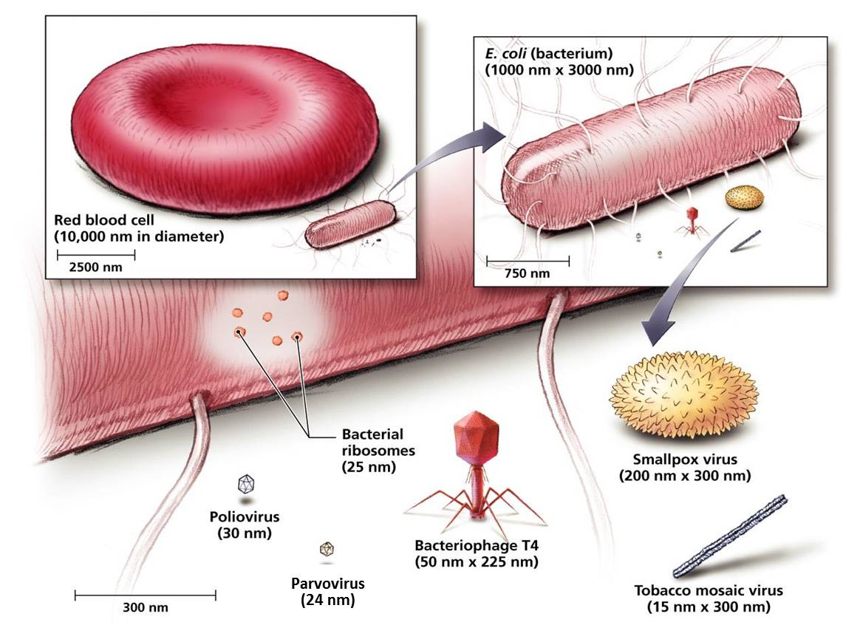
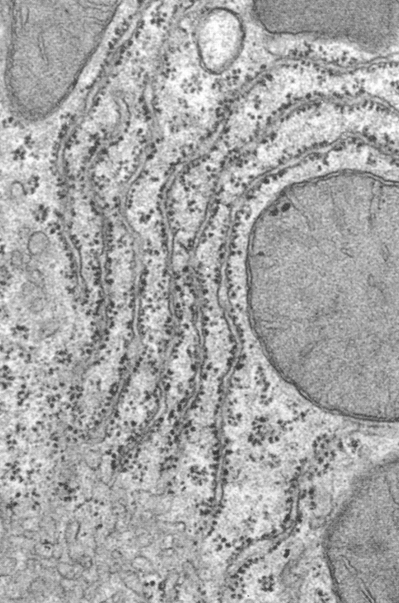
Morphology and Size of Different Viruses
MVM has a similar size as a ribosome

Slide 5

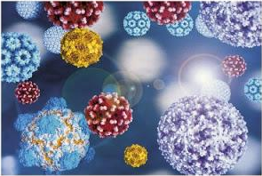


Why are Parvoviruses Interesting?
Important Human Pathogens
B19V, Bocavirus, PARV4, …?
Vectors for Gene Therapy
AAV
Infects humans
Non-pathogenic in humans
Dominant phase of the life cycle: persistent or latent phase
→ site-specific integration into chromosome 19
Oncolytic potential
Rodent parvoviruses: H1-PV / MVM
Worst Case Models for Pathogen Safety in Industry (Biologics)
Highly robust animal parvoviruses (MVM, CPV, PPV,..)
Tools to study host virus interactions
Due to their simplicity parvoviruses strongly depend on their
host cell.

Slide 6
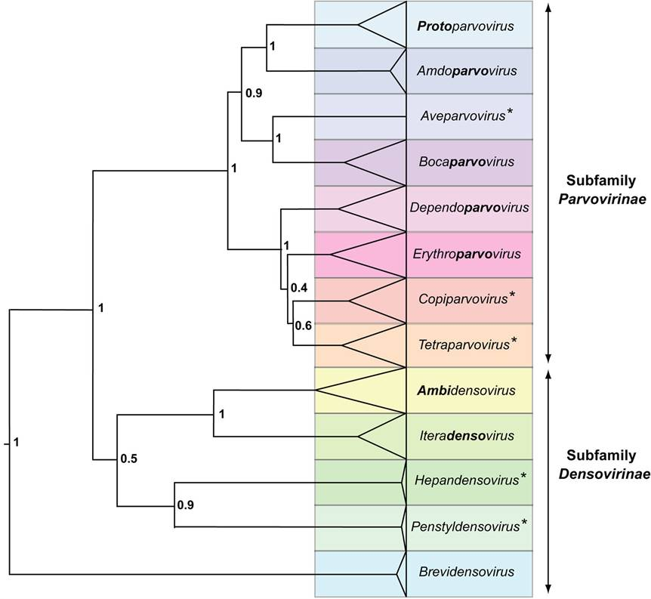

Taxonomy of the Family Parvoviridae
Genera
Subdivision based on
Transcription map
Organization of the ITRs
Ability to replicate autonomously or with a helper virus
Sense of the ssDNA genome
Sequence homology amongst the subfamily

Slide 7

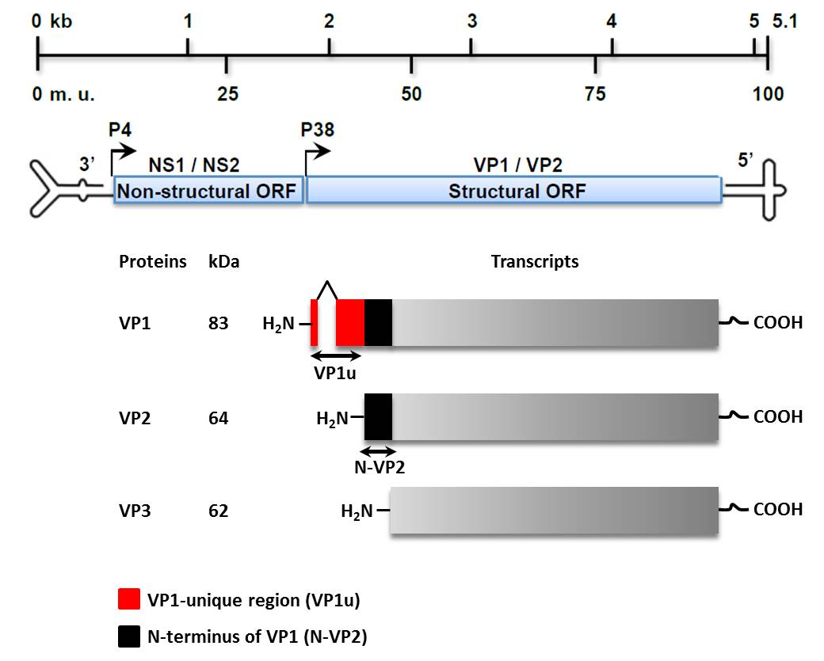
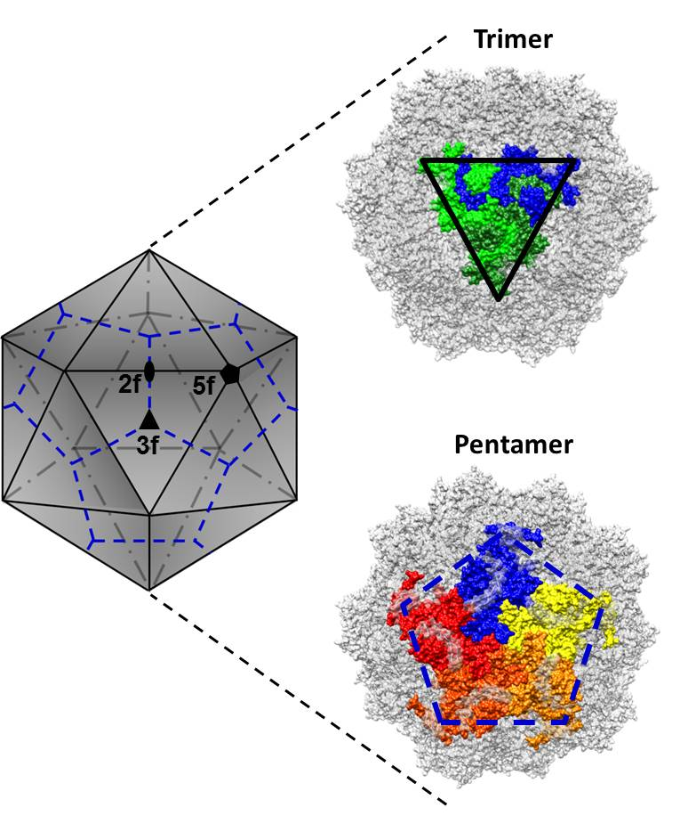
Structure of MVM
VP2

Slide 8
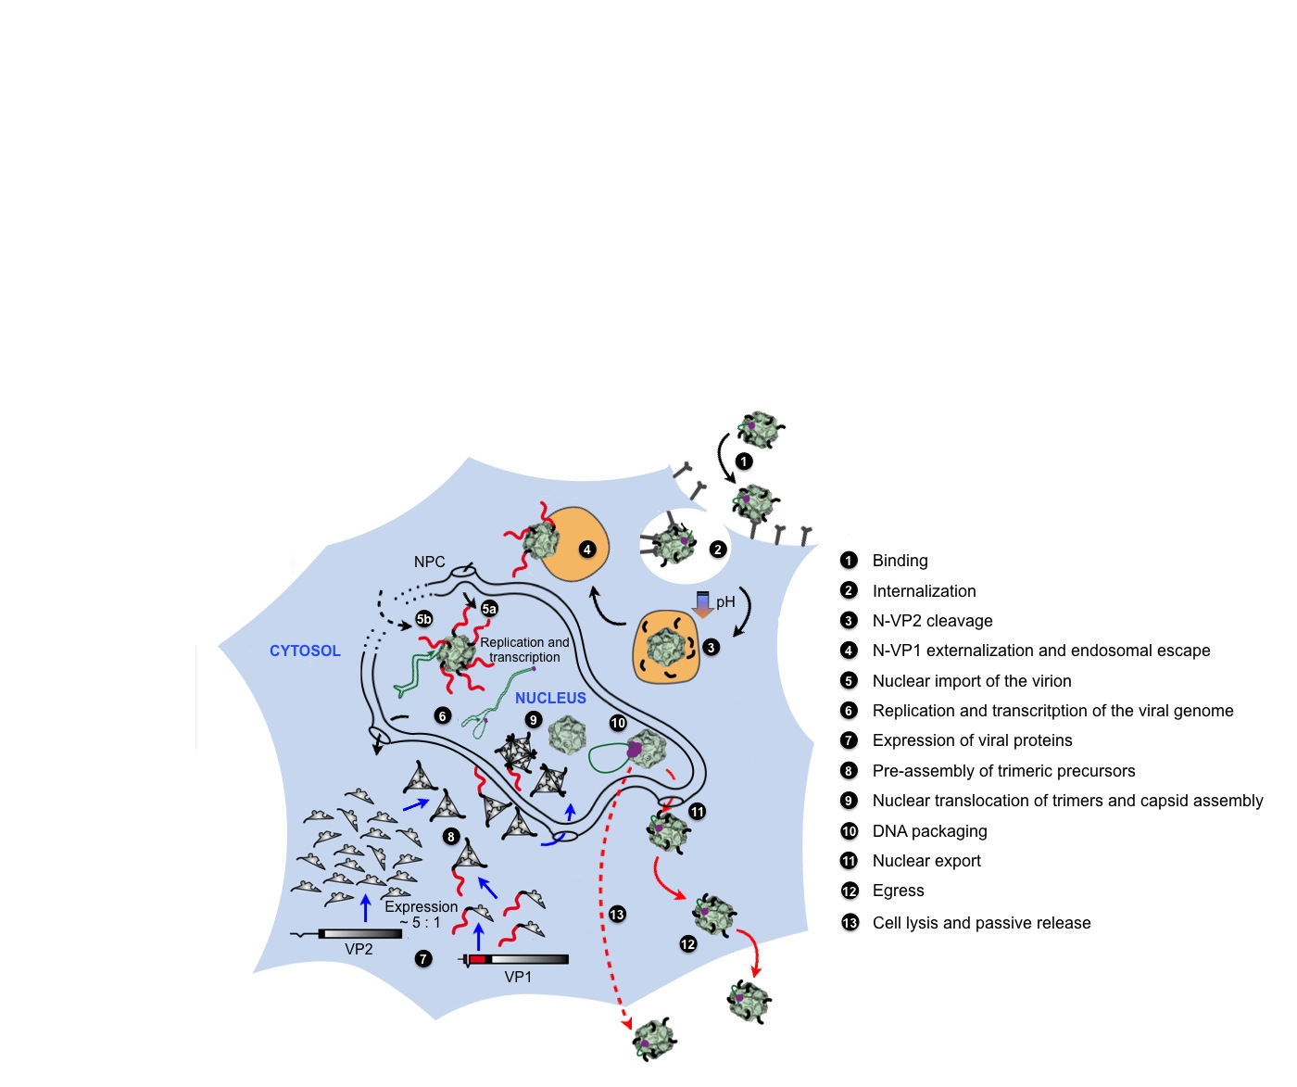
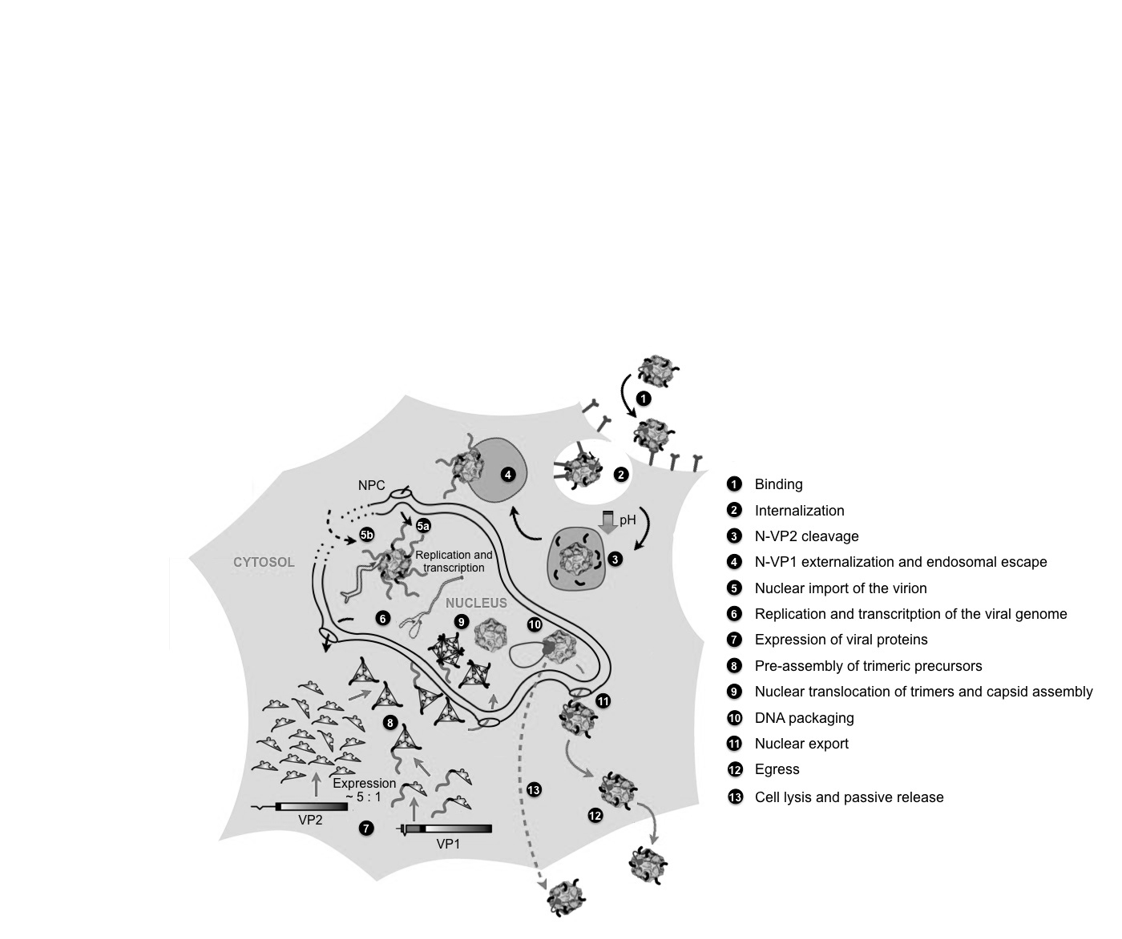

Life Cycle
Is there a Pre-Lytic Active Egress of MVM?
Nuclear Export and Egress
Nuclear export is driven by the extarnalization of N-VP2.
There is growing evidence that an active egress precedes passive cell lysis

Slide 9

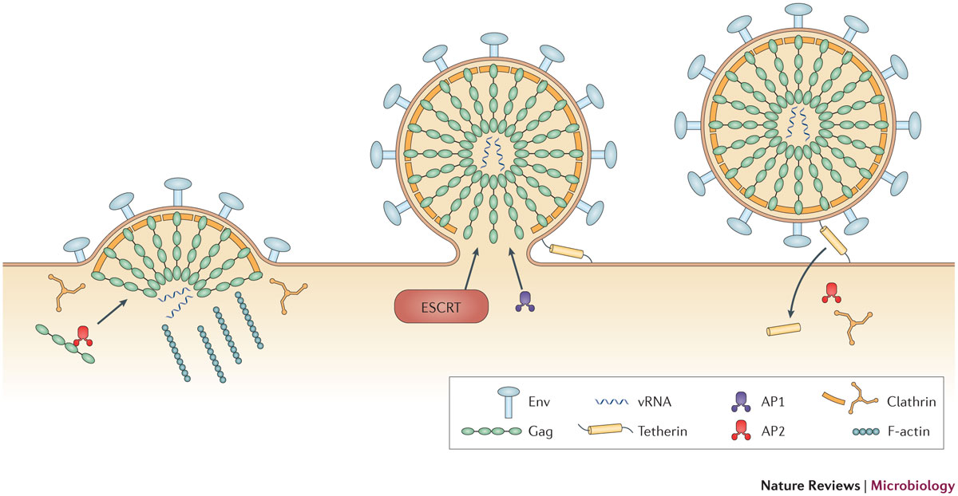
Egress: Basic Principle in Virology
Enveloped viruses: Budding through host cell membranes.
(well characterized)
Examples
Retrovirus
Herpesvirus
Coronavirus
Poxvirus
Non-enveloped viruses: Cell lysis and passive release of progeny virions.
(poorly understood)
Examples
Adenovirus
Parvovirus
Polyomavirus
Reovirus

Slide 10
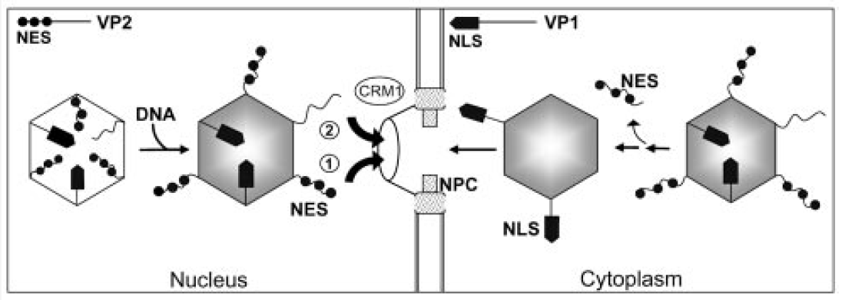
Nuclear Export of Minute Virus of Mice
DNA-packaging triggers N-VP2 externalization:
Pre-assembled empty capsid
Linear ssDNA genome
Full capsid
Phosphoserine-rich N-VP2
Current model for MVM nuclear export:
Phosphorylations have been demonstrated to regulate nuclear import and export by masking NLS or NES sequences or by the introduction of conformational changes.
①
NES activity of highly phosphorylated N-VP2 in transformed cells.
②
Nuclear export is Crm1 dependent in normal murine fibroblasts.

Slide 11
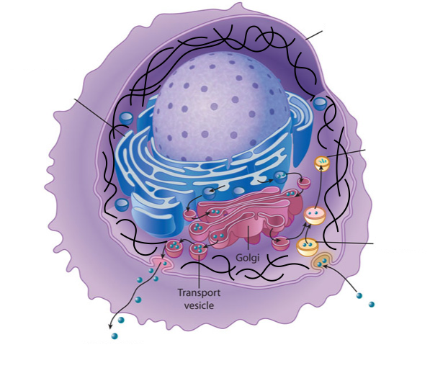
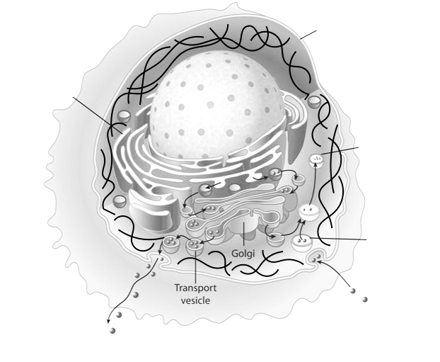
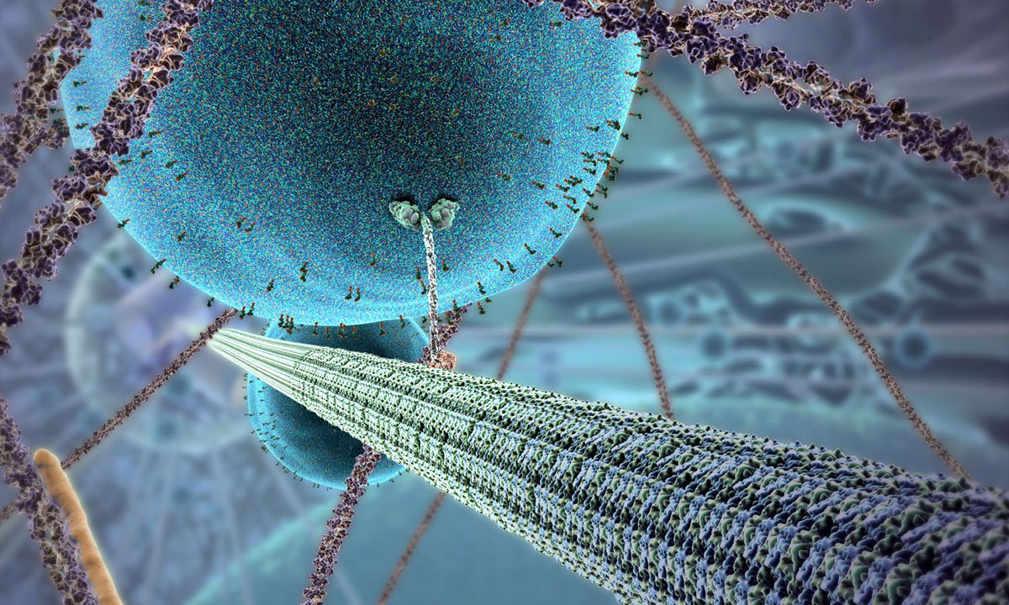
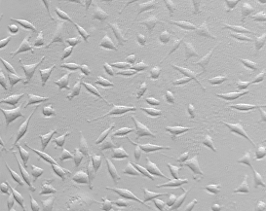
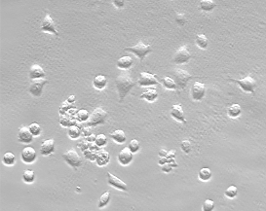
Egress of Minute Virus of Mice
The egress of MVM progeny is a regulated process involving COPII vesicles.
Exocytic vesicles are transported along microtubules mediated by kinesin.
Nucleus
Lysosome
ER
Actin filament
Microtubules are stabilized during the course of infection.
Endosome
10 hpi
40 hpi
Actin filaments are depolymerized during the infection resulting in cell rounding eventually leading to cell death.
ENDOCYTOSIS
EXOCYTOSIS

Slide 12

Challenge
The documentation of active egress by non-enveloped viruses is a difficult task:
Lysis of a few cells passively releases progeny virions.
The discrimination between incoming and progeny virions remains difficult.
The entry and the proposed egress route partially overlap.
Parvoviruses, particularly MVM, are highly robust and can persist as intact particles in the lysosomes of infected cells.

Slide 13

Chromatofocusing: Separating Viruses
D440N MVM
CPV
MVM
R²=0.95
pI ≈ 6.0
pI ≈ 5.3
pI ≈ 4.3
Solution: Determination of IEPs of different viruses was possible by performing chromatofocusing!

Slide 14

Strategy
Fast Protein Liquid Chromatography (FPLC)
Anion-exchange chromatography was performed to separate intracellular virions based on their surface properties.
Isolation
Purification
Concentration ...of distinct maturation intermediates
Standard biochemical and molecular biological methods
Investigation of structural and functional characteristics of the isolated populations.
Side-directed mutagenesis
The role of different capsid regions in egress of MVM was studied.

Slide 15

Goals
Basic principle in virology:
The egress of enveloped viruses is well characterized and involves budding trough host cell membranes .
The release of non-enveloped viruses is considered a passive process because it is associated with cellular lysis.
Several recent studies challenge this basic principle suggesting an active egress mechanism for non-enveloped viruses.
Aim:
Confirmation of an active process of nuclear export and egress of MVM progeny virions.
Characterization of critical capsid maturation steps that trigger active pre-lytic egress of MVM.

Slide 16
Isolation of Two Full Capsid (FC) Populations by AEX
AEX profile of MVM
DNase I treatment
Nuclei
(8 dpI)
(18 hpI)
FC-P₂
FC-P₁
FC-P₁
FC-P₂
Two distinct DNA-containing populations of MVM appear in the nucleus of infected cells.
FC-P₁ is predominantly associated with cells.
DNA packaging is not sufficient for N-VP2 externalization!
Only one population of empty capsids (EC) was observed.

Slide 17
FC-P₁ and FC-P₂ Differ in N-VP2 Conformation
Both DNA-containing popiulations are infectious.
Only FC-P₂ exposes the N-terminal part of VP2 (N-VP2).
α-Capsid mAb
Α-N-VP2 pAb
FC-P₁
FC-P₂

Slide 18
N-VP2 Externalization of FC-P₁ Can Be Enforced
*
* CHT: α-Chymotrypsin
N-VP2 externalization does not influence the AEX profile!

Slide 19
Surface Phosphorylations Determine the AEX Profile
WT + λ-Phosphatase
5SG Mutant
5SG Mutant + λ-Phosphatase
FC-P₂ virions contain additional surface phosphorylations.
The corresponding surface phosphorylations are not located within N-VP2.

Slide 20
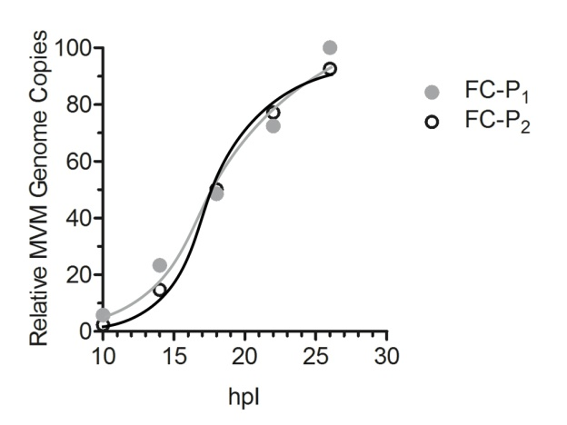
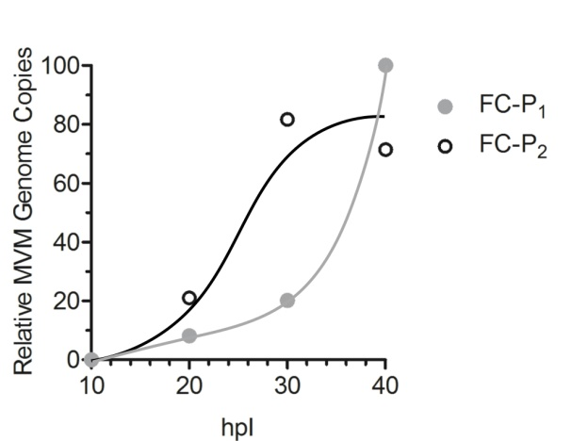
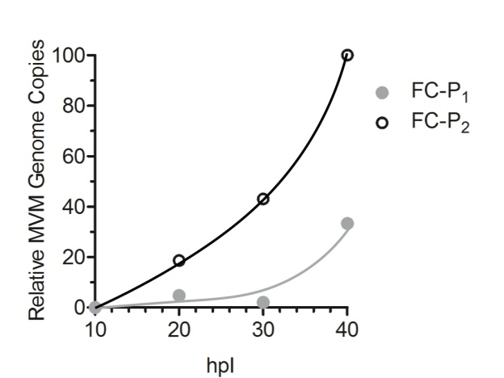
FC-P₂ Can Actively Egress from the Infected Cell
Nucleus
Cytoplasm
Supernatant
Only FC-P₂ has nuclear export potential and can actively egress from the infected host cell.
Onset of cytosysis

Slide 21
Nuclear Accumulation of FC-P₁ Precedes that of FC-P₂
FC-P₁ is the first population to occur in the nucleus of infected murine A9 and human transformed NB324K cells.
In NB324K cells FC-P₁ disappeared progressively to give rise to FC-P₂.
In A9 cells this transfer was less efficient, leading to the accumulation of both populations.

Slide 22
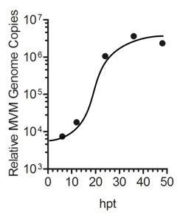
FC-P₁ is the Precursor of FC-P₂
Transfection in NB324K
IP using α Capsid mAb
FC-P₁ is the precursor of FC-P₂

Slide 23
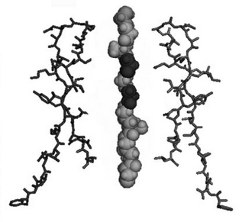
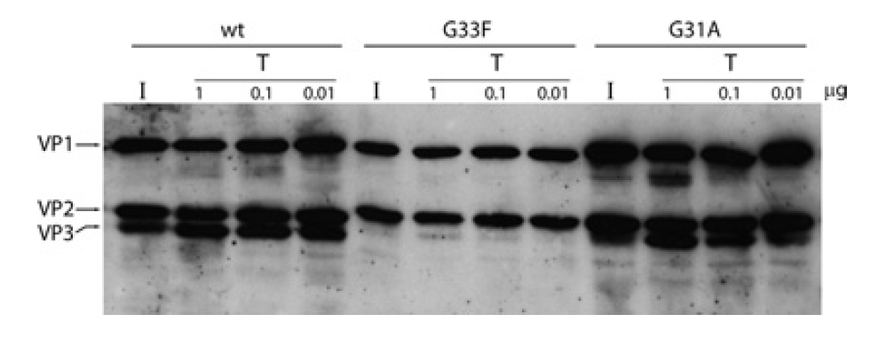
N-VP2 is Dispensable for Active Egress
5-fold channel
24 hpT
OUTSIDE
G33F
N-VP2 is not required for active egress of MVM.
INSIDE
24 hpT
Castellanos M, Pérez R, Rodríguez-Huete A, Grueso E, Almendral JM, Mateu MG. A slender tract of glycine residues is required for translocation of the VP2 protein N-terminal domain through the parvovirus MVM capsid channel to initiate infection. Biochem J. 2013 Oct 1;455(1):87-94.
G33F does not expose N-VP2, thus it is not cleaved upon proteolytic digestion.

Slide 24
…

Slide 25
FC-P₂ Gets Dephosphorylated During Entry
Incoming virions
FC-P₂ particles are processed to generate FC-P₁-like particles.
Acidic endosomal phosphatases remove the surface phosphorylations.
Bafilomycin A₁ (Baf A₁), an inhibitor of the vacuolar-type H⁺-ATPase, abrogated the dephosphorylation of the incoming FC-P₂ population.

Slide 26
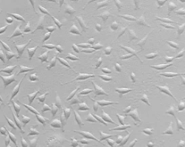
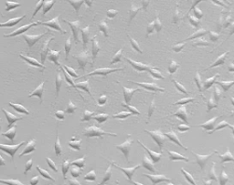
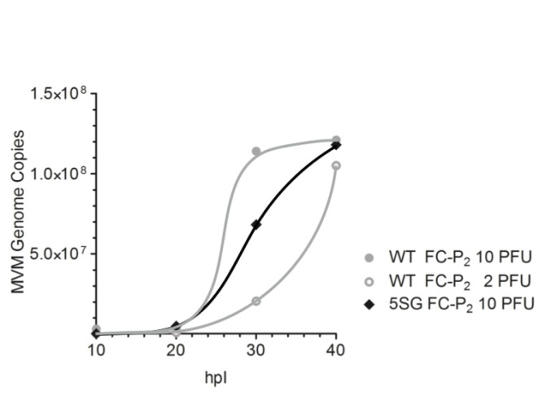
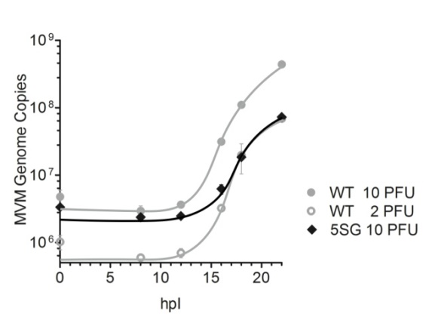
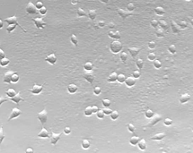
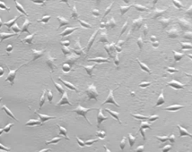
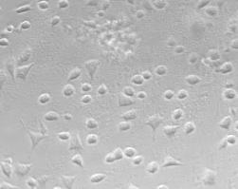
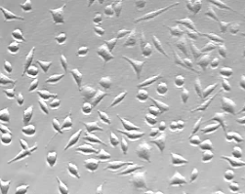
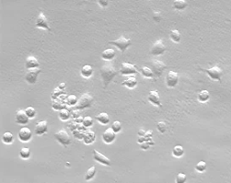
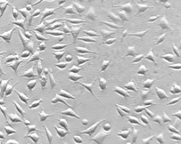
Cytotoxicity
WT
5SG
Nuclear import
(Viral DNA replication)
Nuclear export
10 h
99 %
99 %
20 h
100 %
96 %
30 h
5SG is less efficient in replicating viral DNA in the nucleus, indicating that fewer virions reached the nucleus.
Nuclear export of 5SG progeny is not significantly affected.
The phosphorylations on N-VP2 are likely involved in late events mediating the rearrangement of the cytoskeleton during egress.
98 %
90 %
40 h
58 %
88 %

Slide 28

Conclusion
Anion-exchange chromatography allowed the separation of two different populations of DNA-containing virions.
The populations differed in the conformation of their N-VP2 termini and their surface phosphorylation status.
Nuclear export and active egress prior to cytolysis was observed only for the late FC-P₂ population.
N-VP2 is not significantly involved in nuclear export and active pre-lytic egress of MVM. However, it might facilitate cytolysis and passive egress.
The surface phosphorylations are strictly associated to nuclear export potential. Moreover, they are removed from incoming virions during endosomal trafficking.
These temporally and spatially controlled changes in surface phosphorylations would provide nuclear import and export potential required to fulfill the complete life cycle of a karyophilic virus.

Slide 29




Acknowledgements
It is a pleasure to thank those who made my thesis possible…
Christoph Kempf
Carlos Ros
Nico Ruprecht
Remo Leisi
Marcus von Nordheim
Michel Boinay
Alessio Loffreda
Aurélie Allemann
Chiarina Di Tommaso
Seline Zürcher
Achim Stocker
Walter Aeschimann
José María Almendral
Carlos Dominguez Redondo
Jon Gil Ranedo
Josefa González Nicolás
Marta Pérez Illana
Aroa Tato de la Torre

Slide 34



Slide 36
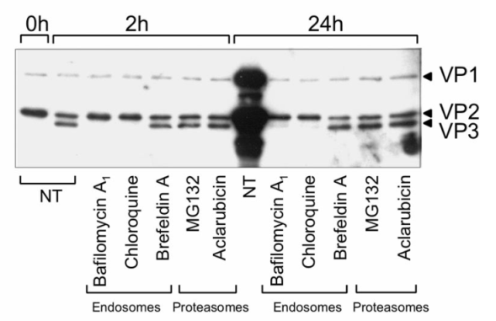
FC-P₁
FC-P₂
5 min
6 h
6 h
+ BafA₁
Mani B, Baltzer C, Valle N, Almendral JM, Kempf C, Ros C. Low pH-dependent endosomal processing of the incoming parvovirus minute virus of mice virion leads to externalization of the VP1 N-terminal sequence (N-VP1), N-VP2 cleavage, and uncoating of the full-length genome. J Virol. 2006 Jan;80(2):1015-24.

Slide 37
Review: Nuclear Import/Export … find also nice illustration for conclusion..

Slide 38
WT
G33F Mutant
ssDNA
N-VP2 with serine phosphorylations
N-VP2 of 5SG mutant
F
G33F
H₂N MSDGTSQPDSGNAVHSAARVERAADGPGGSGGGGSGGGGVGVSTGS COOH
1
5
10
15
20
25
30
35
40
45

Slide 39
A9
NB324K
(Murine fibroblasts)
(Human transformed cells)
FC-P₁
FC-P₂
FC-P₁
FC-P₂
10 h
10 h
FC-P₁
FC-P₂
24 h
14 h
14 h
48 h
18 h
18 h

Slide 40
WT
5SG Mutant
ssDNA
N-VP2 with serine phosphorylations
N-VP2 of 5SG mutant
G
G
G
G
G
H₂N MSDGTSQPDSGNAVHSAARVERAADGPGGSGGGGSGGGGVGVSTGS COOH
1
5
10
15
20
25
30
35
40
45

Slide 41
Why are Parvoviruses Interesting?
Advantages
Extremely robust
Non-enveloped
Very small
18-24 nm
Human pathogens
B19V, Bocavirus, PARV4, …?
Applications
Well characterized
Animal parvoviruses
Oncolytic capacity
Gene therapy
AAV gene therapy vectors
Pathogen safety (Worst case models)
Animal parvoviruses (CPV, MVM)

Slide 42
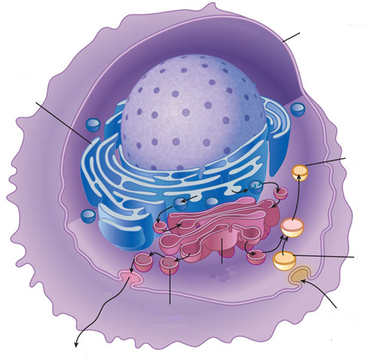
Cell Membrane
Egress of progeny virions from the nuclear periphery to the plasma membrane through ER and Golgi is a regulated process involving COPII vesicles (Bär et al., 2008). This pathway is not only needed to induce post-assembly modification to mature progeny particles, but also for the coordinated release of virions by induction of cytolysis (Bär et al., 2013).
Endoplasmic Reticulum
Lysosome
Endosome
ENDOCYTOSIS
EXOCYTOSIS

Slide 44
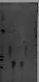
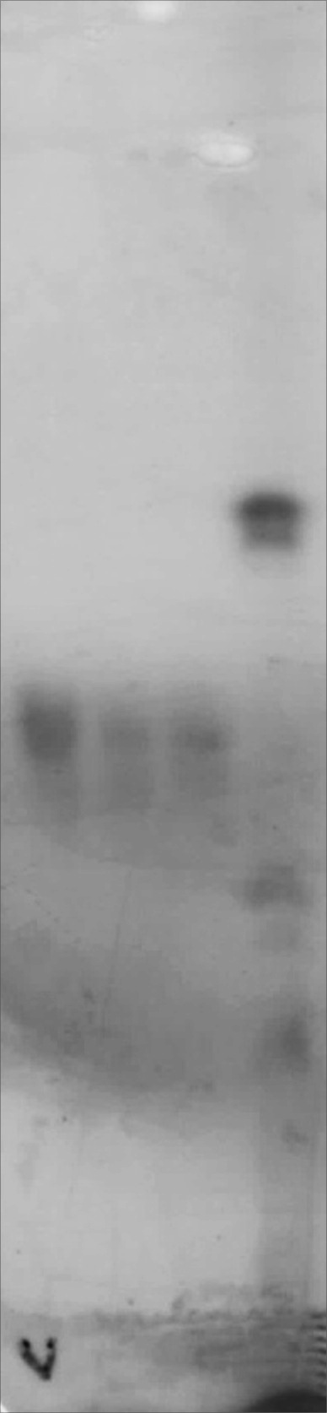
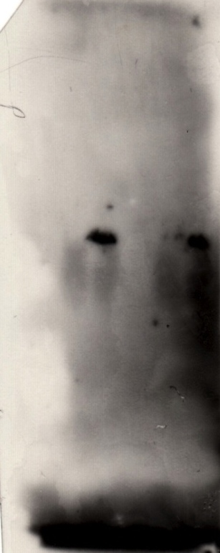

Iseolectric Focusing
BSA
Carboanhydrase
90 ug
60 ug
120 ug
10⁸ EC
10⁸ FC
10⁹ EC
pI
BSA
pI
10⁹ FC
pI
6.0
6.0
6.0
5.9
5.3
5.3
5.3
5.2
5.2
5.2
4.7
4.7
4.7
Sample Application
4.5
4.5
4.5
4.2
4.2
4.2
3.8
3.8
3.8
Problem: Mobilization of viral particles in 0.8% agarose gels.

Slide 45
https://www.google.ch/search?q=troubles&biw=1440&bih=791&source=lnms&tbm=isch&sa=X&ved=0CAYQ_AUoAWoVChMIiNye_fHVyAIVy7UUCh0tLgAL#tbm=isch&tbs=rimg%3ACfBW0KVwiI7TIjg31otRmn6caT--lbTycMGHYK4saJI8YczwWLyHRS9PEaAzxEfPCNUjZ3Apqw1jOMzNccBxvDR5ZCoSCTfWi1GafpxpEfTxbQVmA89_1KhIJP76VtPJwwYcRLk9jT-LN5JEqEglgrixokjxhzBEsthGRwrZNRSoSCfBYvIdFL08REfNnFD4bQMnRKhIJoDPER88I1SMRdzeQcUqvON8qEglncCmrDWM4zBE2iZ237eVbRSoSCc1xwHG8NHlkEc1fMjr_1GaaN&q=Problem%20m%C3%A4nnlein&imgrc=dLB2ZGnQj4_liM%3A

Slide 46
The assembly of retroviruses requires three major components: Gag, envelope protein (Env) and the genomic viral RNAs (vRNAs). These components are transported to distinct sites in the plasma membrane, where retroviral assembly and budding occur. Budding is coordinated through late domains in Gag, which facilitate the interaction of Gag with components of the ESCRT (endosomal sorting complex required for transport) machinery and thus coordinate outward membrane deformation. The endocytic and cytoskeletal machineries have been implicated in the budding process, but their precise roles remain unclear. To date, proposed mechanisms include the binding of adaptor protein complex 2 (AP2) to Gag to restrict Gag localization to the plasma membrane, as well as binding of AP1 to Gag and components of the ESCRT complex to facilitate budding by an unknown mechanism. In addition, clathrin localizes to the budding site and becomes incorporated into the viral particle, and thus might regulate the spatial organization of viral proteins to facilitate accurate assembly. The cytoskeletal machinery is implicated in providing force to promote efficient assembly and budding; however, as yet, no interplay between the endocytic proteins and actin has been observed in this system. To allow a progeny virus particle to be released, the host protein tetherin, which physically tethers the particle to the plasma membrane, must be counteracted. Both AP2 and clathrin have been implicated in the removal of tetherin from the budding site

Slide 47


Karyophilic Viruses
Advantages
Disadvantages
Use of cellular DNA and RNA polymerases.
Advantage of the RNA-splicing machinery for RNA processing.
Exploitation of the cellular chromatin for integration into the host’s genome.
Nuclear import and export required
→ nuclear envelope as an additional obstacle
Consequences
Nuclear import
Nuclear export
of the incoming viral genome
of non-structural, regulatory viral proteins
of de novo synthesized viral structural proteins
of transcribed mRNAs for translation in the cytosol
of assembled viral capsids and nucleoproteins

Slide 48
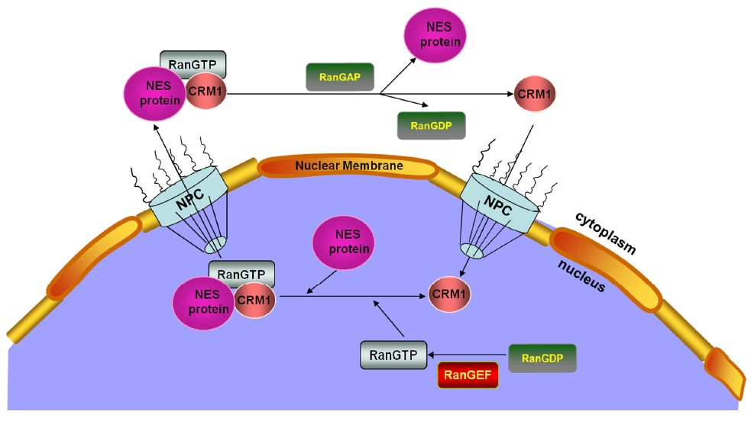
Nuclear Export
Classical model for nuclear export:
RAN-GTP-Exportin Complex binds to Cargo protein, resulting in nuclear export.
Cargo is released in the cytoplasm upon hydrolyzation of Ran-GTP to Ran-GDP.
Current model for MVM nuclear export:
Phosphorylations have been demonstrated to regulate nuclear import and export by masking NLS or NES sequences or by the introduction of conformational changes.
①
NES activity of highly phosphorylated N-VP2 in transformed cells
②
Nuclear export is Crm1 dependent in normal murine fibroblasts.

